Slide 1


ROUTE OPTIMIZATION FOR PREVENTION OF STREET HARRASSMENT IN MEDELLIN

Slide 2


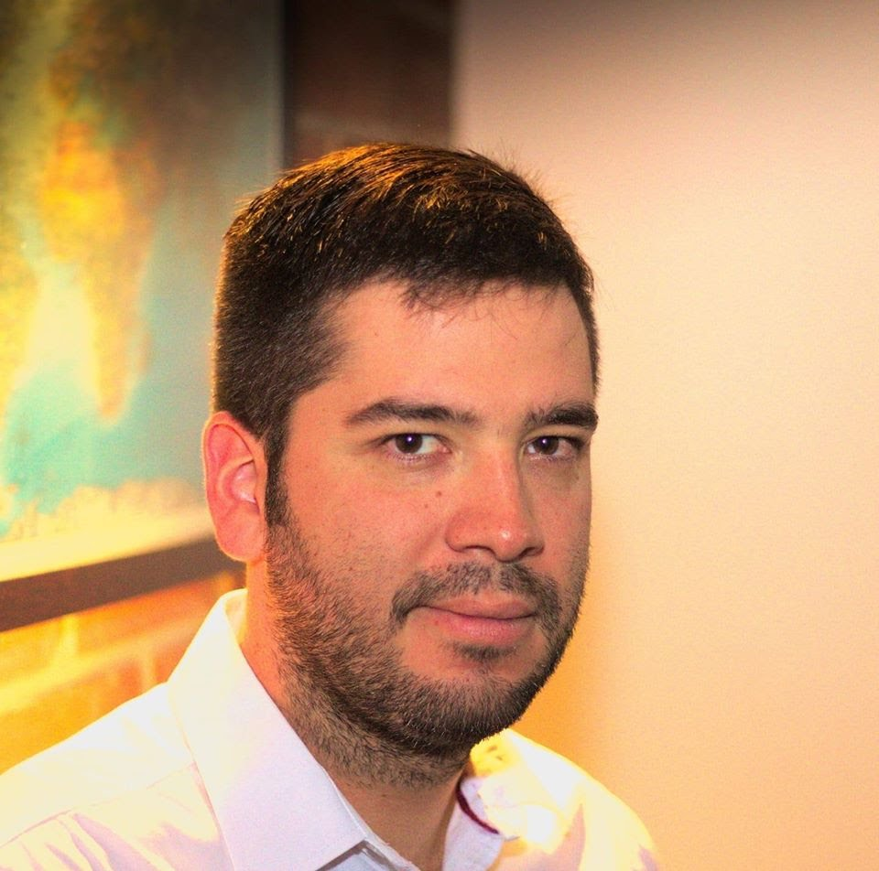

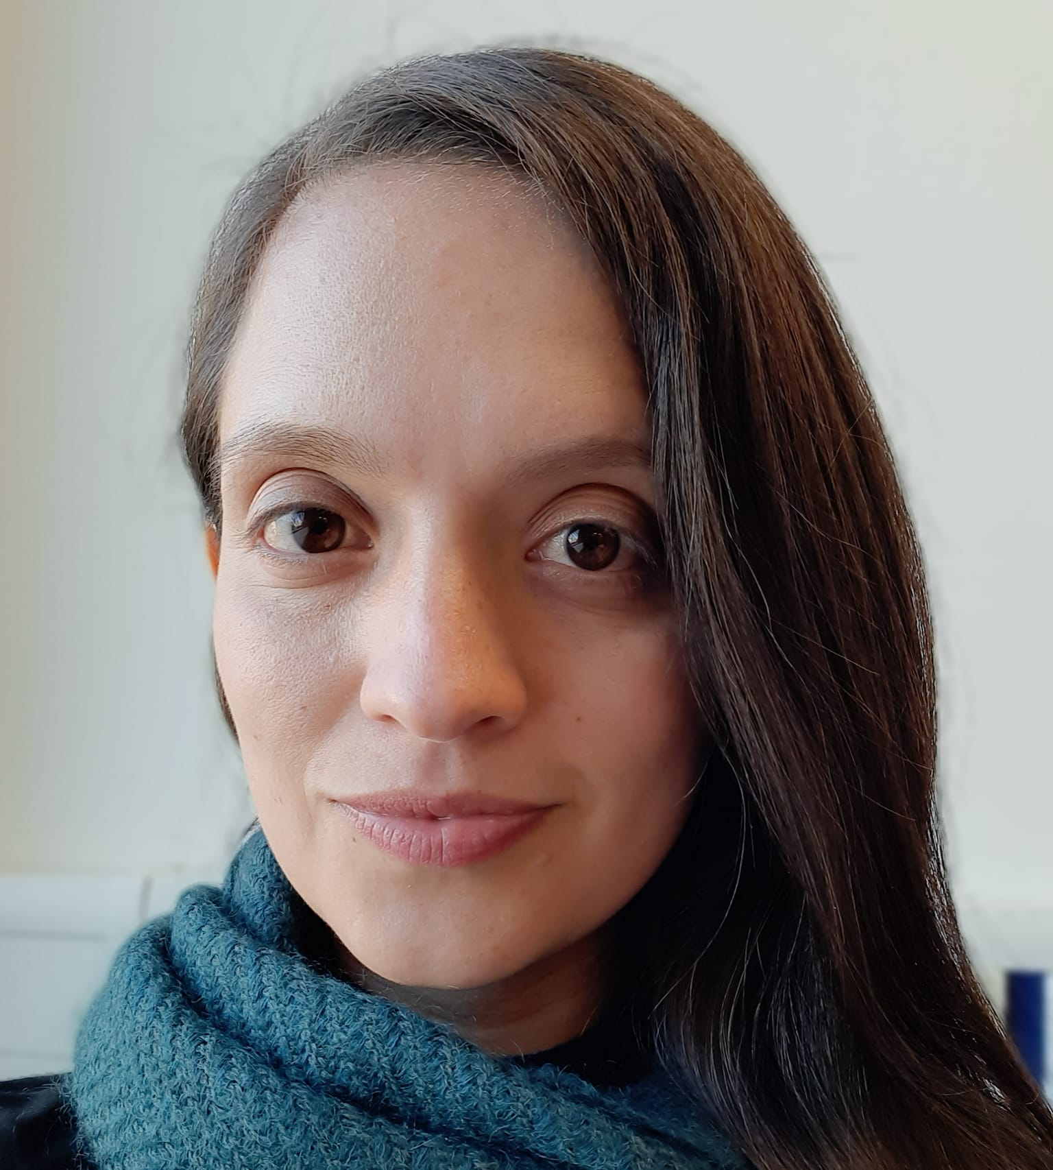

Our wonderful team!
Thomas Martinod
Leader
Emanuel Serna
Programmer
Andrea Serna
Literature reviewer
Mauricio Toro
Consultant
https://github.com/ThomasMartinod/SafeMED/

Slide 3
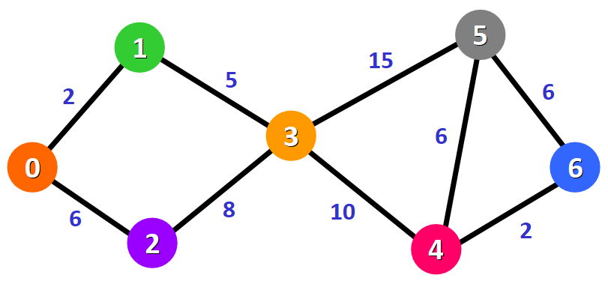

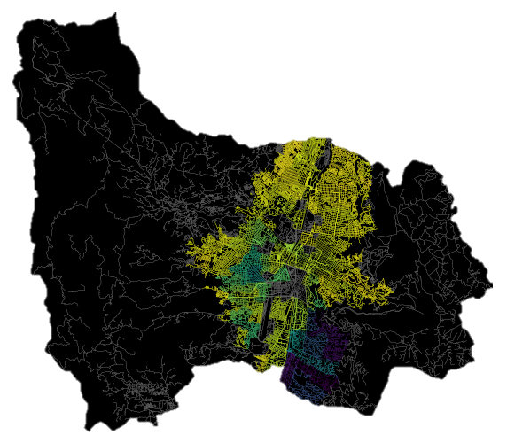
Problem to solve

Slide 4
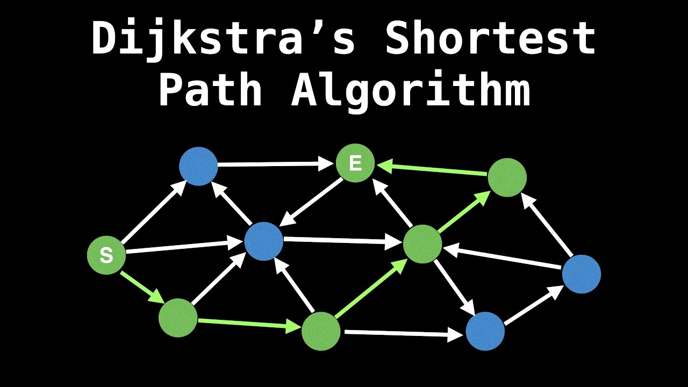
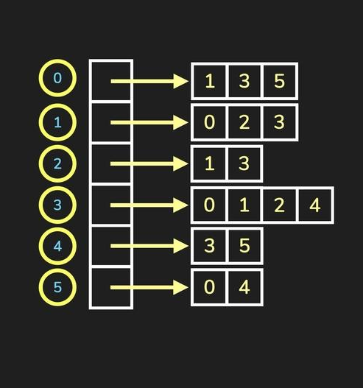
Implemented algorithm

Slide 5


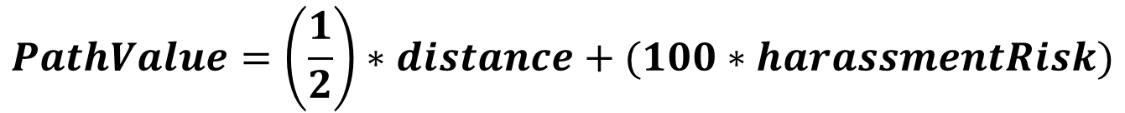
Combining distance and harassment risk
$$PathValue=\left(\frac{1}{2}\right)∗distance+(100∗harassmentRisk)$$

Slide 6
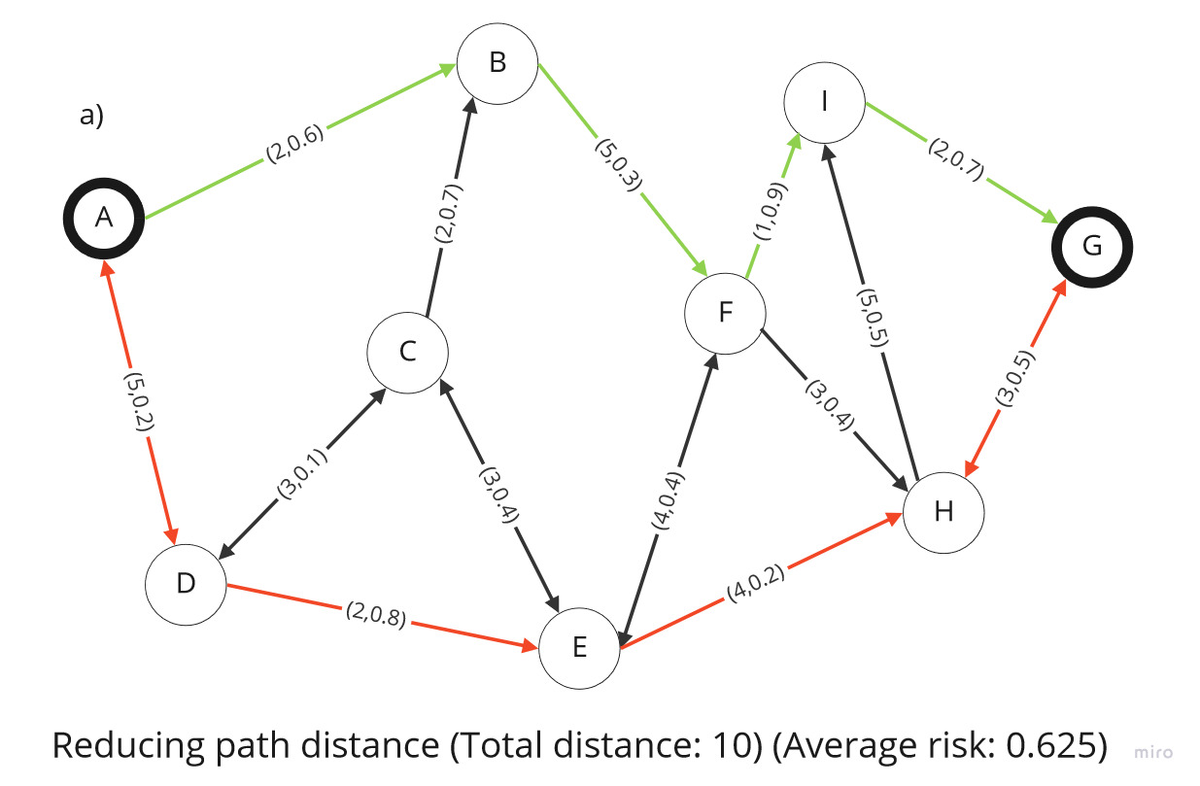
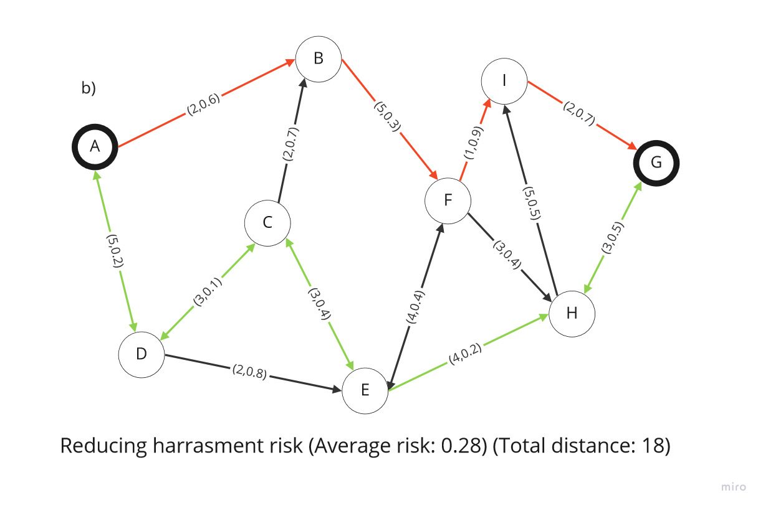
Explaining our solution
https://github.com/ThomasMartinod/SafeMED/

Slide 7
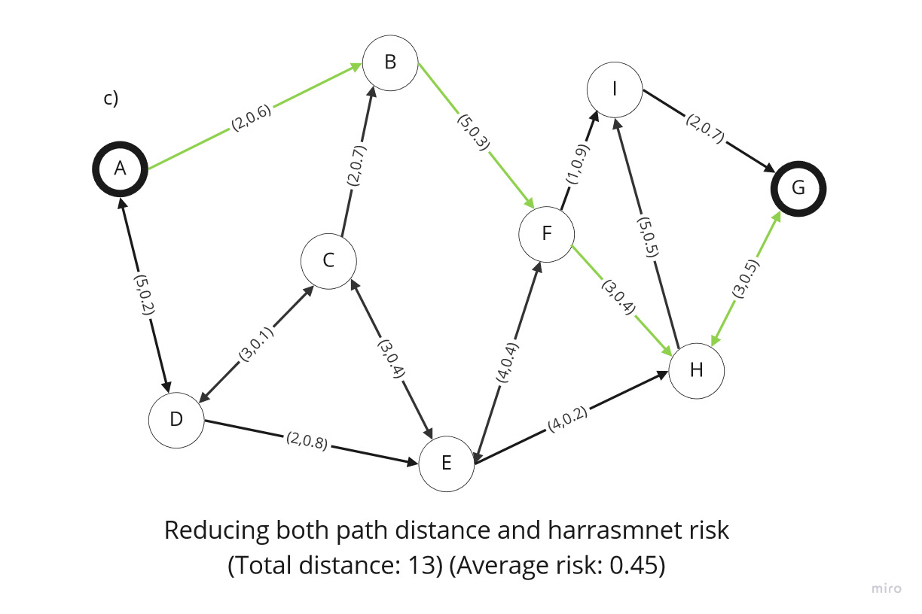
Explaining our solution
https://github.com/ThomasMartinod/SafeMED/

